Slide 1

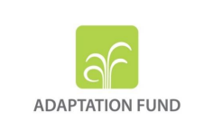


3rd Meeting
Expert Working Group on Floods
(Ulcinj, Montenegro)
Background Report on Status of FRM in the Drin River Basin
October 2023

Slide 2
Table of Contents
Why a Transboundary Basin needs a Common Flood Policy ?
Main Steps of the Drin/Drim Dialogue (2001 – 2023)
Main Outputs of the GEF Drin Project
Main Outputs of the AF Drin FRM Project (Components 1, 2, 3)
Selected Projects Related to the FRM in the Drin Basin
Other Projects Related to the FRM in the Drin Basin
Comprehensive List of the Drin Riparian FRM Measures
Climate Change in the Drin Basin (Observed Trends, Expected Alterations)
Remarks

Slide 3
Why a Transboundary Basin needs a Common Flood Policy ?
According to the EU-FD, in case of shared basins the Member States must coordinate their FRM (ONE single FRM Plan) based on the principle of solidarity, not undertaking measures that have the potential to significantly increase flood risk up-stream or down-stream in the basin.
Despite floods being a predominate hazard factor, there is no basin-wide FRM strategy or/and plan addressing climate-induced flood risks in place.
FRM investment is not supported by robust climate-risk informed analysis, and there are no investment plans and no comprehensive financial risk transfer mechanisms to address flooding.
Full integration of socio-economic and environmental effects in process of defining and selection of measures is still at early stages and a basin wide approach including transboundary effects is usually not fully considered by any of the Drin riparian.
National flood management have been designed based on “traditional” approaches while recorded events and economic losses have questioned their efficiency and sustainability on long-term. A paradigm shift is needed from traditional FRM at national level to integrated FRM at the basin level.

Slide 4
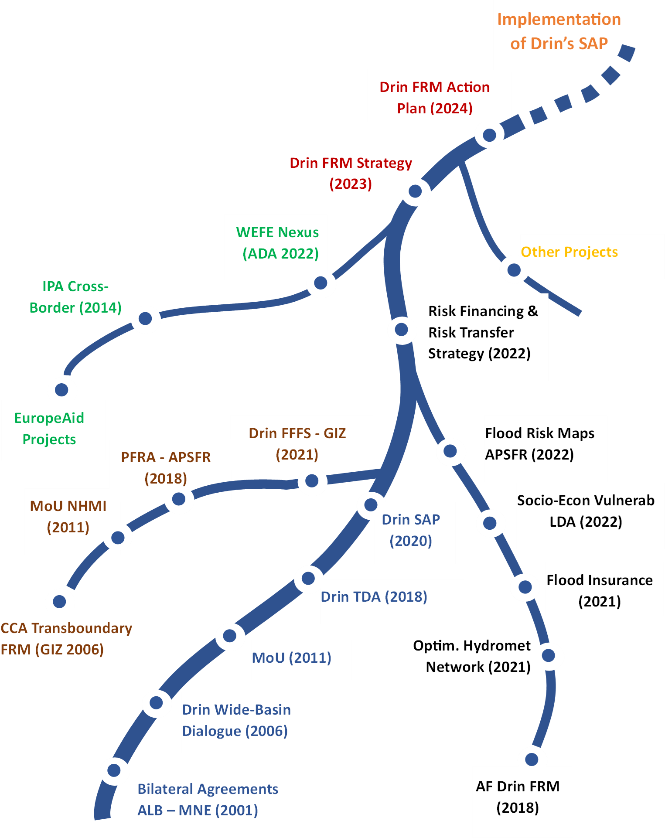
Main Steps of the Drin Dialogue (2001 – 2023)
We are Here
Cornerstone Projects of the Transboundary Drin FRM Dialogue
GIZ - Climate Change Adaptation through Transboundary Flood Risk Management in the Western Balkans (2006 – 2021)
GEF Drin Project (GWP – Med, UNDP, UNECE, 2018)
AF Drin FRM Project (GWP – Med, UNDP, 2018 - 2024)

Slide 5
Main Outputs of the GEF Drin Project
MoU (2011), Art 2. Shared Vision
The Parties, through their Ministers and their representatives, commit to promote joint action for the coordinated integrated management of the shared water resources in the Drin Basin, as a means to safeguard and restore to the extent possible the ecosystems and the services they provide, and to promote sustainable development across the Drin Basin.
TDA (2018), Transboundary Diagnostic Analysis
The TDA identified 4 common transboundary concerns: a) Deterioration of Water Quality; b) Variability of the Hydrological Regime; c) Biodiversity Degradation, d) Disturbance of the natural Sediment Transport regime
Regarding the high variability of the hydrological regime (Floods & Droughts), to address the multiple causes a Strategic Action Programme is requested (IFRM).
SAP (2020), Strategic Action Programme (Goal, Objective, Spec. Mngment Actions)
GOAL 3: Develop cooperation measures to minimize risks of disasters due to extreme natural phenomena and climate change by 2030.
Obj. 1: Improved coordinated management among Riparians for flood risks by 2030
Obj. 2: Improved coordinated management among Riparians for drought risks by 2030
The Implementation of Drin’s SAP shall be Based on Permanent EWG Floods

Slide 6
Main Outputs of the AF Drin FRM Project
Component 1: Hazard and Risk Knowledge Management Tools
Output 1.1. Strengthened hydrometric monitoring networks in the riparian countries based on a unified optimized basin-scale assessment of monitoring needs
  Optimized basin hydrometric network plan, Hydrometric network O&M plan, Financing mechanism
Output 1.2. Improved knowledge of CC-induced flood risk and risk knowledge sharing through the introduction of river basin modeling tools and technologies for strategic flood risk assessment based on EUFD and development of basin flood hazard maps
  Flood Risk Assessment & Flood Risk Mapping based on the EU Floods Directive (Hydrological and Hydraulic modeling of the APSFRs of Albania, and N. Macedonia)
Output 1.3. GIS-based vulnerability, loss and damages assessment tools and database established to record, analyze and predict flood events and associated losses
  Socio-economic Risk Prioritization Model to support the detailed engineering design of the structural measures. Vulnerability, Loss & Damage Assessment

Slide 7
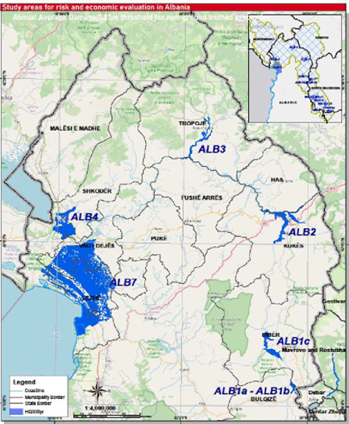
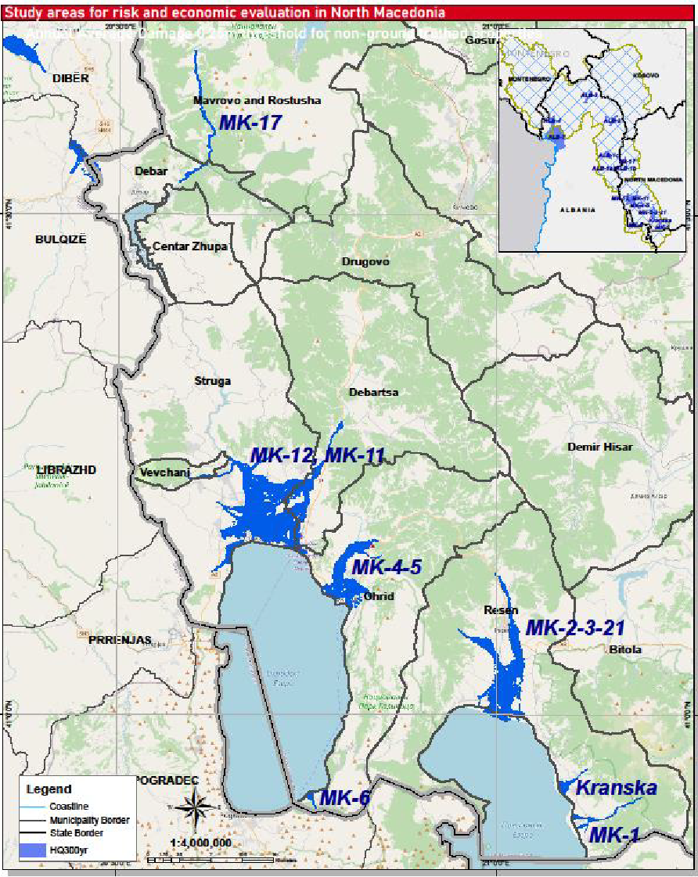
Main Outputs of the AF Drin FRM Project
Component 1: Hazard and Risk Knowledge Management Tools
APSFRs Albania
APSFRs North Macedonia

Slide 8
Main Outputs of the AF Drin FRM Project
Component 2: Transboundary Institutional, Legislative & Policy Framework for FRM
Output 2.1. Drin River Basin FRM Policy Framework and improved long-term cooperation on FRM
  Institutional mapping for Flood Risk Management in the Drin Basin
  Review of the legislative and policy framework in Integrated Flood Risk Management (IFRM) in the Drin basin
  Flood Insurance, Skadar/Shkoder Lake-Buna/Bojana River and Struga in Ohrid Lake
  Status on the implementation of the EU Directives in the Drin Riparian states
Output 2.2. Regional, national and sub-national institutions (including meteorological and hydrological sectors) are trained in climate-resilient FRM, responsibilities clarified and coordination strengthened
  Capacity assessment and capacity development plan in the context of IFRM
  Training Courses on Hydrological & Hydraulic Modelling, ….
Output 2.3. Drin River basin Integrated CCA and FRM Strategy and Plan developed
  Current Project (in Progress)

Slide 9
Main Outputs of the AF Drin FRM Project
Component 3: Community-Based Climate Change Adaptation & FRM Interventions
Output 3.1. Introduction of appraisal-led design for structural and non-structural measures using climate risk information and cost-benefit appraisal methods and application of methods to the detailed design of prioritized structural and non-structural measures for three riparian countries
  To be illustrated in the UNDP Workshop, Development of the FRM Strategy and the Plan (Tirana 18 Oct. 2023)
Output 3.2. Construction of structural risk reduction measures in prioritized areas
  To be illustrated in the UNDP Workshop, Development of the FRM Strategy and the Plan (Tirana 18 Oct. 2023)
Output 3.3. Strengthened community resilience to flooding through the participatory design and implementation of non-structural community-based resilience, adaptation and awareness measures
  To be illustrated in the UNDP Workshop, Development of the FRM Strategy and the Plan (Tirana 18 Oct. 2023)

Slide 10
Selected Projects Related to the FRM in the Drin Basin
Transboundary Level
  Preliminary Flood Risk Assessment Drin/Drim – Buna/Bojana River Basin (GIZ, 2018)
  IPA Cross-border Cooperation Programme MNE – ALB (2022
  Nexus Assessment for the Drin River Basin (Phase II – 2022)
  DIKTAS - Protection & Sustainable Use of Dinaric Karst Transboundary Aquifer (2014)
Albania
  Flood Risk Management Plan Shkodër Region (GIZ, 2021)
  National Civil Protection Agency, Disaster Risk Assessment in Albania (2021)
  MARD, Drin-Buna Final River Basin Management Plan (2019)
Kosovo
  Integrated Water Resources Management in Kosovo’ (Drini i Bardhë RBMP, 2022)
  Preliminary Flood Risk Assessment (PFRA) for All River Basins in Kosovo (2021)
Montenegro
  Strengthening the Capacities for Implementation of the WFD in Montenegro (2018)
  Implementation and Monitoring of Water Management in Montenegro (2021)
  Flood Risk Management Plan for the Adriatic River Basin (2023)
  North Macedonia
  Implementation of the EU Floods Directive through Harmonization of National Legislation and Preparation of Flood Risk Management Plan (IPA II)*

Slide 11
Other Projects Related to the FRM in the Drin Basin
N° | Project Name | ALB | MNE | NMK | KOS
1 | Assessment Water-Energy-Food-Ecosystems Nexus in Albania (2022) | X
2 | Lake Ohrid Watershed Management Plan (2020) | X |  | X
3 | Design and testing of a multipurpose transboundary groundwater monitoring network in the Extended Drin River Basin (2020) | X | X
4 | Water and Climate Change Vulnerability in the Western Balkans (2018) | X | X | X | X
5 | Integrated Resources Management Plan for Buna/Bojana Area (2015) | X | X
9 | Development of hydrological and hydraulic study of the regulation of Skadar Lake and Bojana River water regime IPA project (2014) |  | X
10 | Major Issues, Problems, and Drivers in the Drin Basin (2014) | X | X | X | X
11 | Restoration of the Prespa Lake Ecosystem (implementation of the Prespa Lake Watershed Management Plan) (2013) | X |  | X
12 | Characterization of transboundary aquifers in Dinaric karst, base study for sustainable water management at a regional and local scale (2012) | X | X
13 | A Post-Disaster Comprehensive Flood Risk Assessment & Management (2012) | X | X
14 | Hydrology of the transboundary Drin River Basin (2011) | X | X | X | X
15 | Contribution to Sediment Management Drin River hydropower cascade, | X
16 | Lake Shkoder Transboundary Diagnostics Analysis (2006) | X | X
17 | Lake Skadar-Shkodra Integrated Ecosystem Management | X | X

Slide 12
Comprehensive List of the Drin Riparian FRM Measures
Summary of main Flood Risk Mitigation Measures recommended in the different projects*

Slide 13
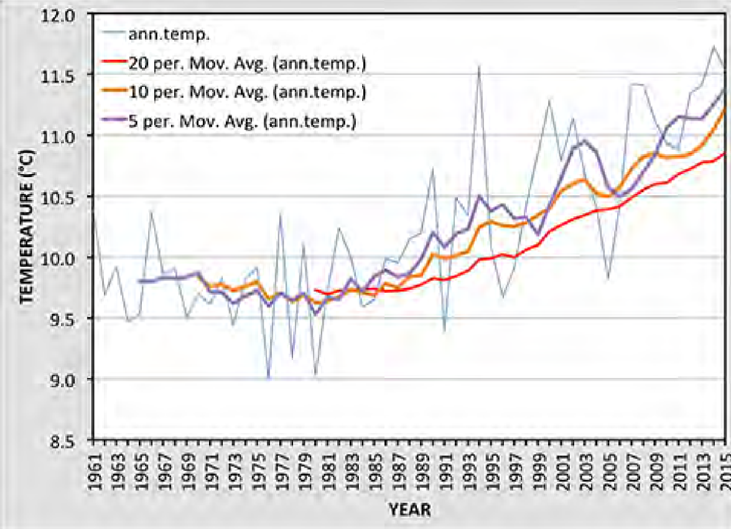
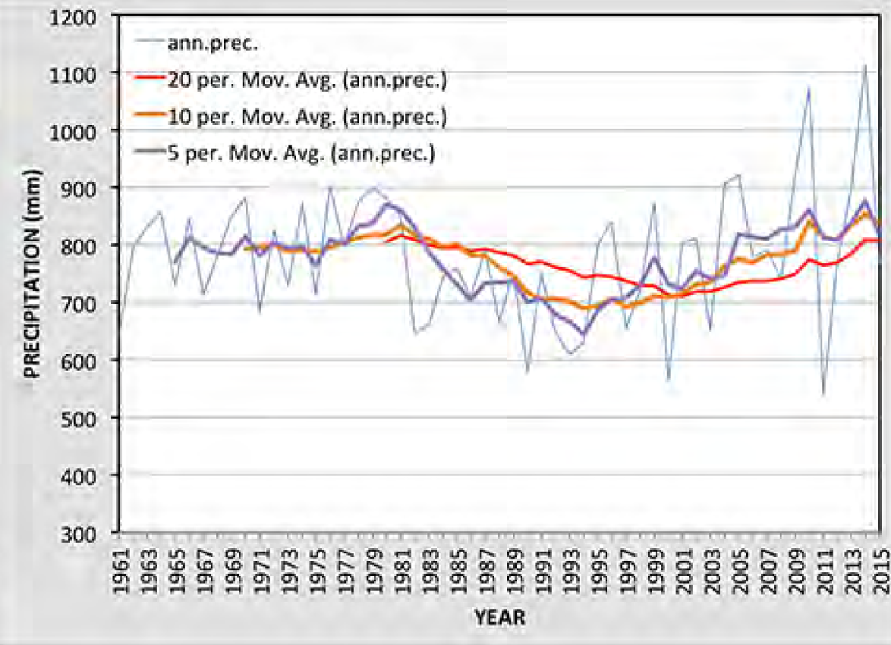
Climate Change in the Drin Basin
Observed Trends (1961 – 2015)
Annual Temperature
Annual Precipitation

Slide 14
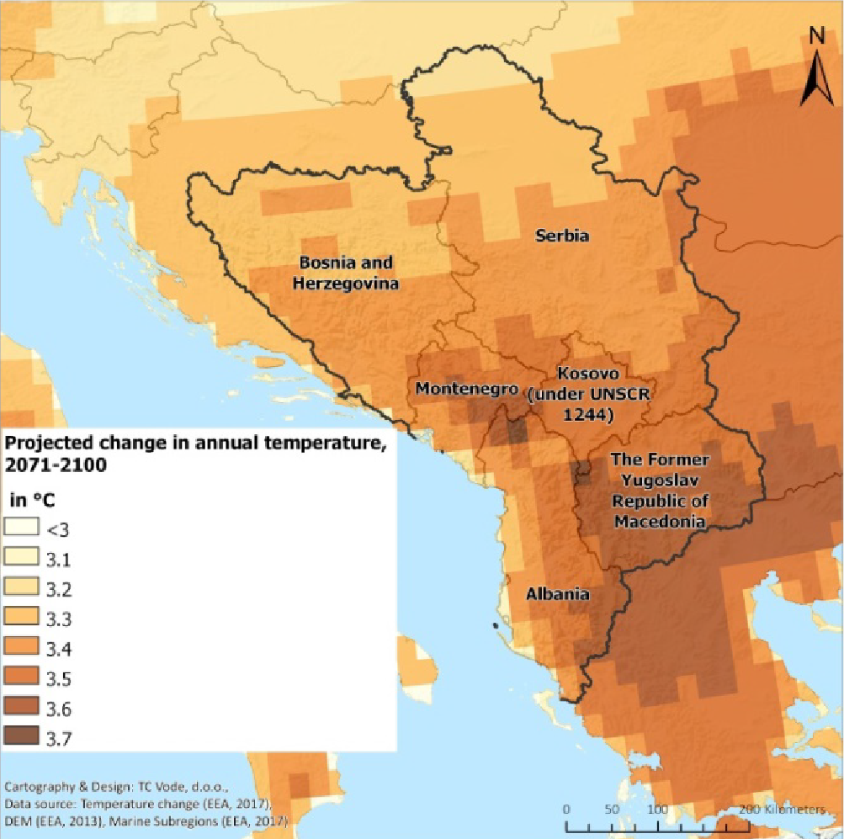
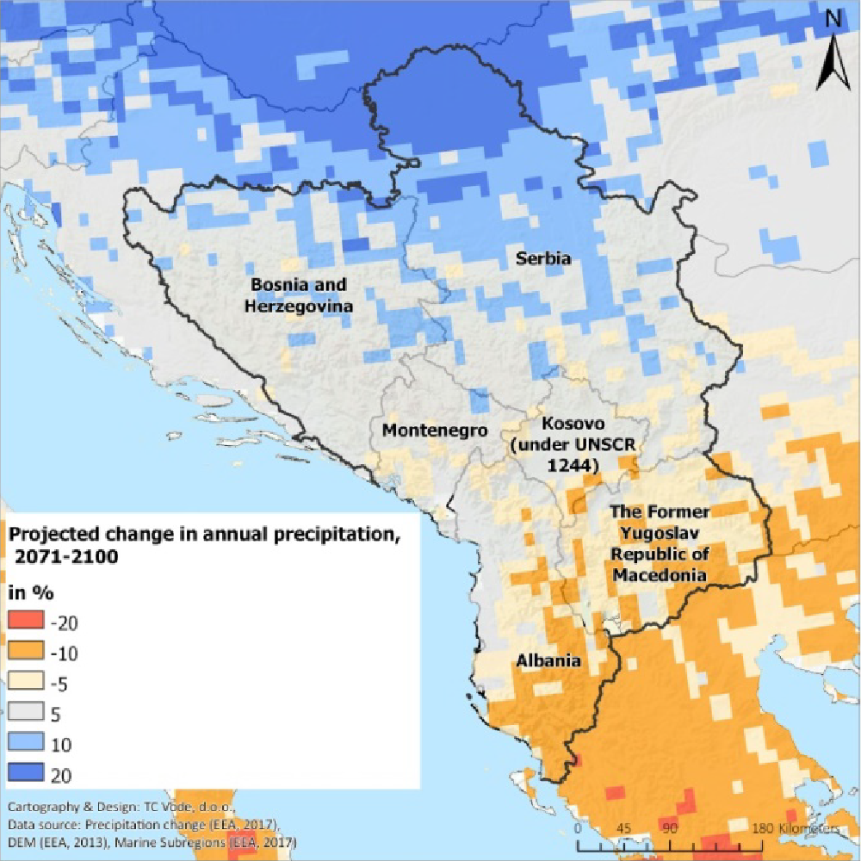
Climate Change in the Drin Basin
Climate Projections RCP 8.5 (2071 - 2100)
Projected Change in
Annual Temperature
Projected Change in Annual Precipitation

Slide 15
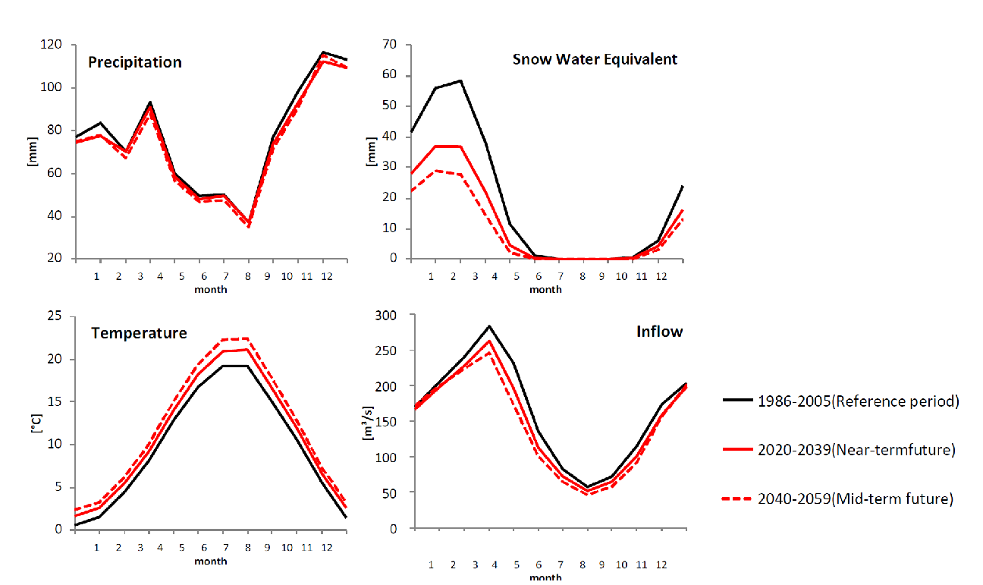
Climate Change in the Drin Basin
Expected Alterations on the Annual Regimes @ Fierza (Near, Mid-term)
HSCRG – Hydropower Sector Climate Resilience Guide (KESH, 2022)
Small decrease of Precipitation, significant rise of Temp & EV (summer), outstanding reduction of Snow storage (winter), moderate reduction of annual Inflow (5 % Near-term ; 10 % Mid-term)

Slide 16
Some Remarks
The D2 report collects & summarizes the main outputs of the tens of projects carried out in the Drin River Basin in the FRM sector in the last 20 years.
The D2 report constitutes the basis for the developing of the Drin FRM Strategy and FRM Action Plan. An in-depth knowledge of the causes and effects of prevailing hazards is a prerequisite for effective and efficient FRM.
The D2 refers to the original docs collected, although most reports were published recently, some points need to be up-dated. During the Consultation process, the EWG and key stakeholders will be requested to please review and confirm a list of specific points.
On-balance, the cumulative work and the results achieved by the different projects is enormous.

Slide 17
Some Remarks
As the project includes a Consensus & Stakeholders Engagement Process, to easily a common understanding of the Drin Basin challenges, an Executive Summary of the main reports will be translated to the different riparian languages. The documents will be available at the Web-platform floods.drinbasin.org
The report can be used as a general reference or “existing knowledge repository” on the status of FRM in the Drin Basin
There are several areas that need additional technical assessment to reduce the level of uncertainty, most of the results shall be considered the output of the 1st cycle (Art. 14 EU FD, updating cycle every 6 years ).

Slide 18
THANKS

